Slide 1
Internet’s Impact on our lives
By:Marcus E, Matthew C

Slide 2
Background Story
Without the internet the world of gaming could have never been the way it is today. A lot of people these days use gaming in which pertains to the internet. It's a way to chat with friends within a long distance and play the games you love at the same time. If internet would have not been here would you ever enjoy the game the same way that you do when playing with friends. Obviously not so the internet is something that has change the world of gaming within its entirety.

Slide 3
Using ASCII art to code a line of text
// _ _ _ _ _ _ _ _ _ _ _ _ _ _ _ _ _ // ( T ) ( h ) ( e ) ( w ) ( o ) ( r ) ( l ) ( d ) ( o ) ( f ) ( g ) ( a ) ( m ) ( i ) ( n ) ( g ) // _ _ _ _ _ _ _ _ _ _ _ _ _ _ _ _ _
The world of gaming
The world of gaming

Slide 4
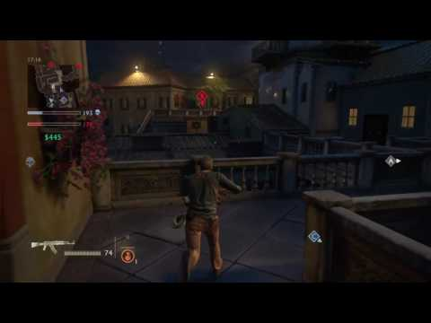
This video contains a clip of online gameplay and using the internet to broadcast gameplay. Without the internet his would not be able to be achieved. It makes things for fun when the word “multiplayer” becomes incorporated. Instead of using of phone lines as internet you have wireless internet.

